Slide 1


Rites of Passage
A Heroes' Journey

Slide 3
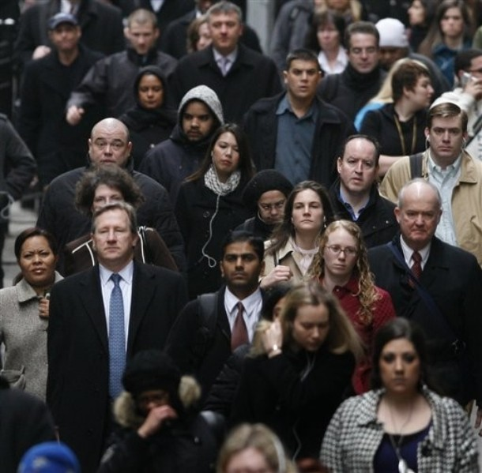
Ordinary World:
The hero's normal world before the story begins

Slide 4
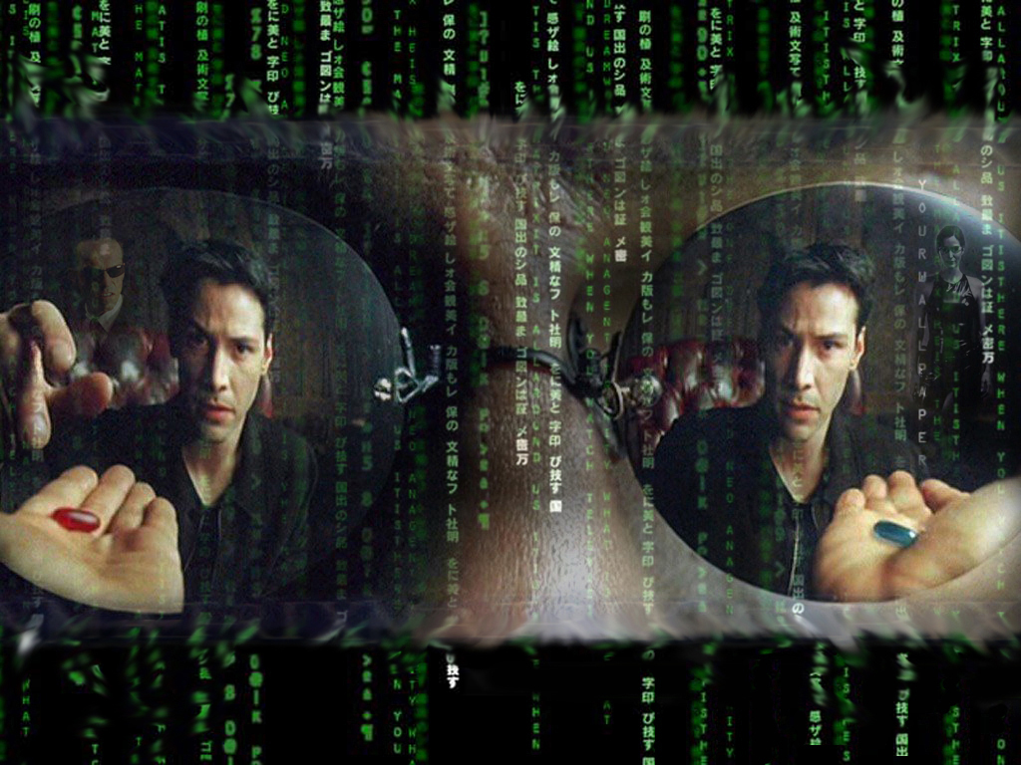
Call to Adventure:
The hero is presented with a problem, challenge

Slide 5
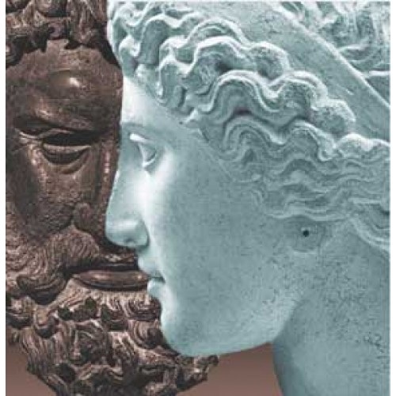

Refusal of the Call:
The hero refuses the challenge or journey

Slide 6
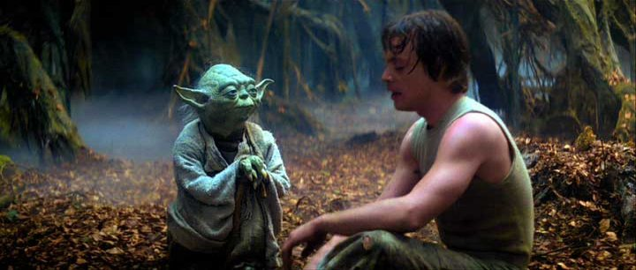
Meeting with the Mentor:
The hero meets a mentor to gain advice or training

Slide 7
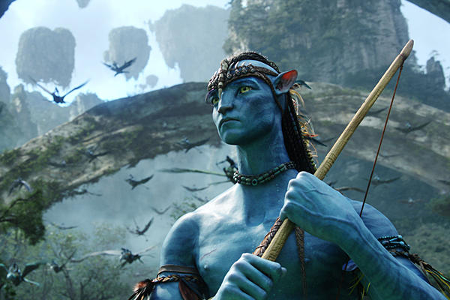
Crossing the First Threshold:
The hero leaves the ordinary world and goes into the special world

Slide 8
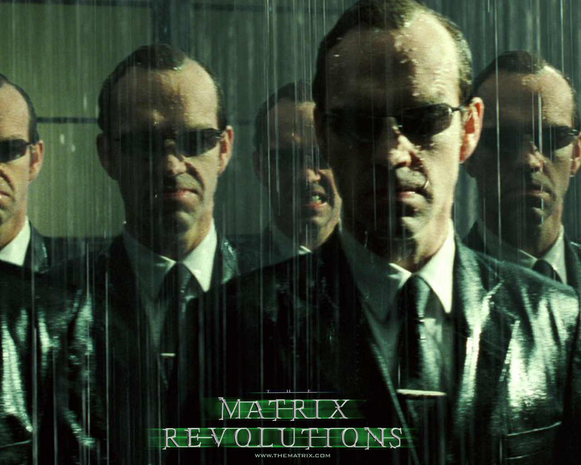
Tests, Allies, Enemies :
The hero faces tests, meets allies, confronts enemies & learns the rules of the Special World.

Slide 9
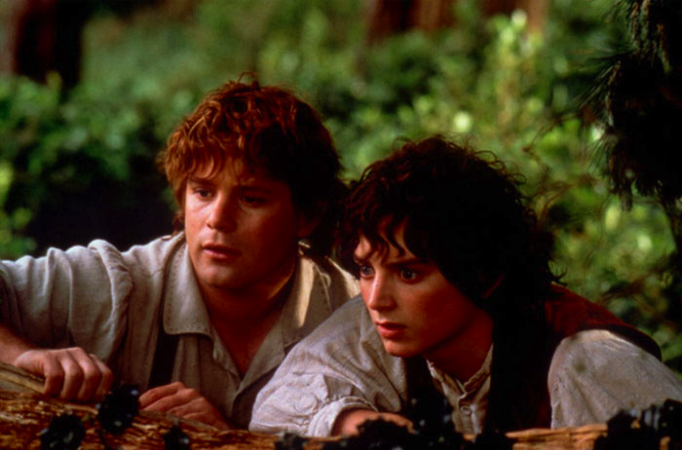
Approach:
The hero has hit setbacks during tests & may need to try a new idea.

Slide 10
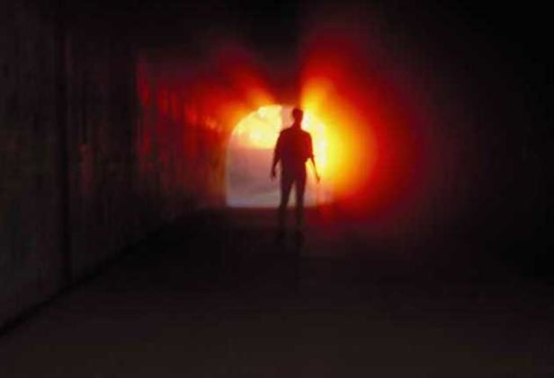
Ordeal:
The biggest life or death crisis.

Slide 11
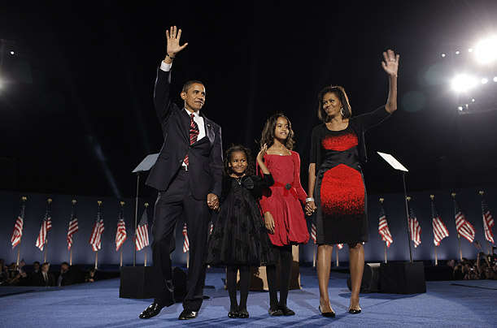
Reward:
The hero has survived, overcomes his fear and now earns the reward .

Slide 12
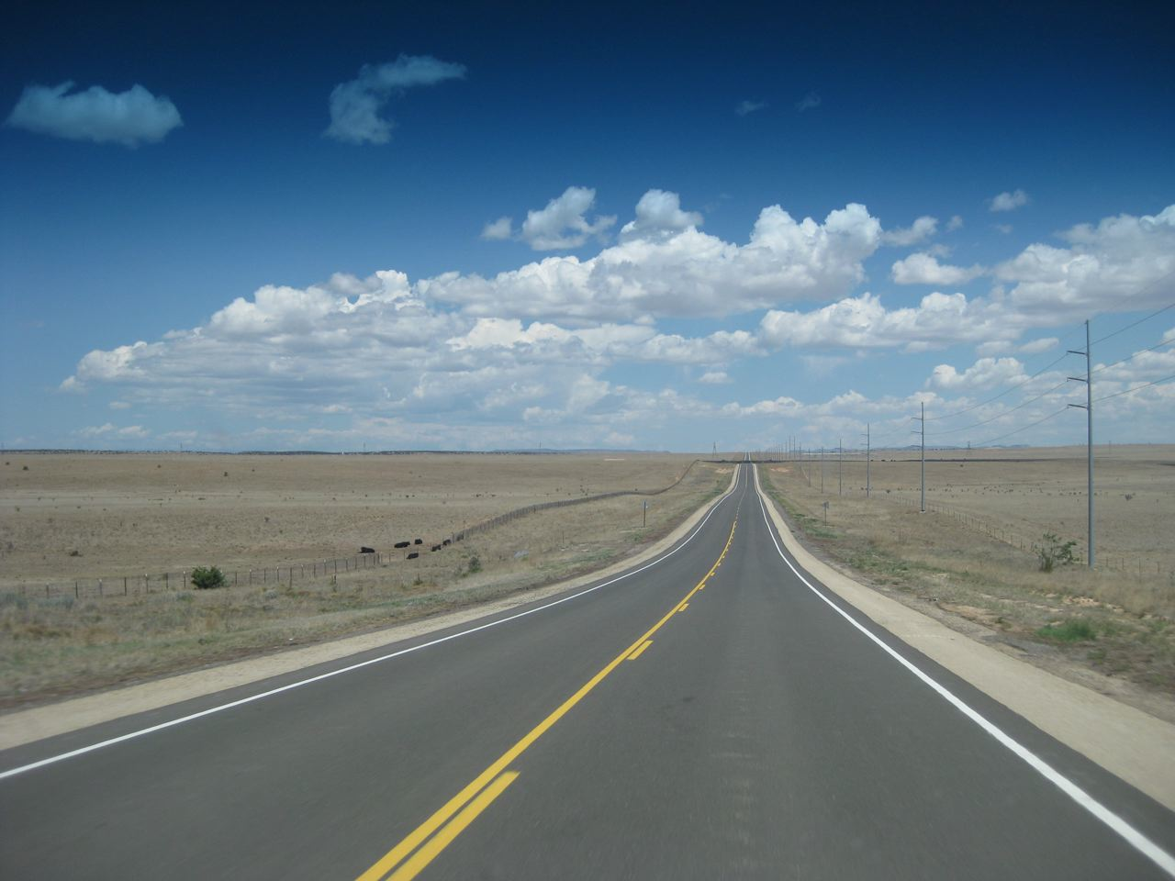
The Road Back :
The hero must return to the Ordinary World.

Slide 13
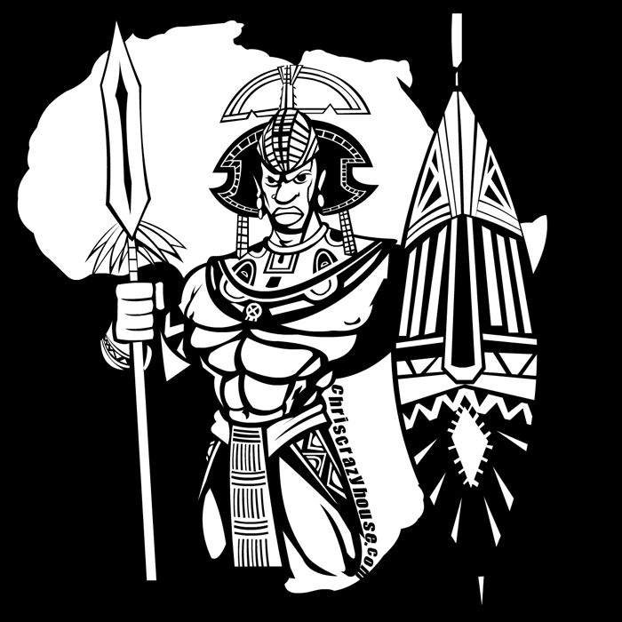
Resurrection Hero :
Another test where the hero faces death – he has to use everything he's learned .

Slide 14
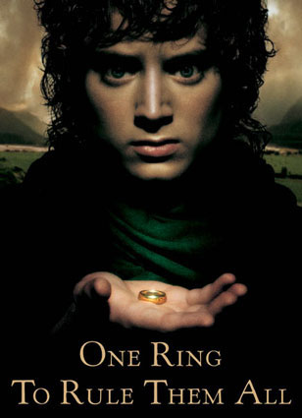
Return with Elixir:
The hero returns from the journey with the “elixir”, and uses it to help everyone in the Ordinary World.

Slide 15
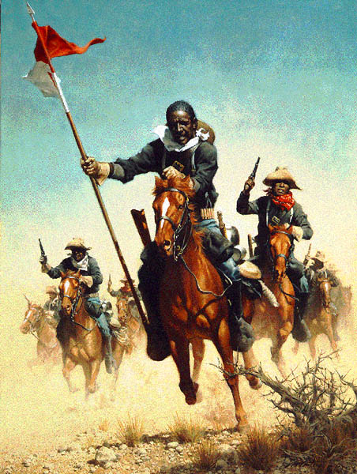
People often wonder what a Hero is, what makes a man a Hero?
Is it the horse he rides in on?

Slide 16

Could
it be the
people he is
with?
You know,
the company he
keeps?

Slide 17
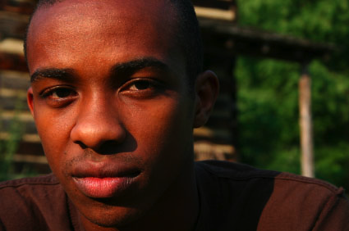
No, usually, the Hero starts early in us!
Usually, the Hero comes from within!

Slide 18
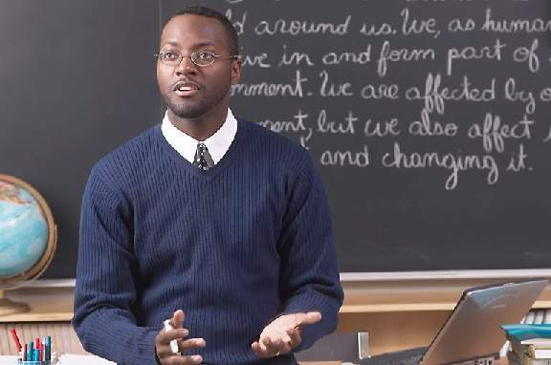
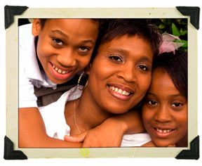
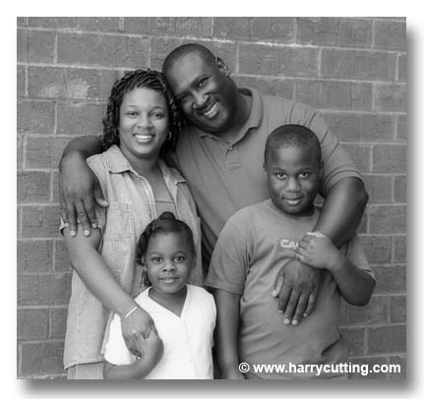
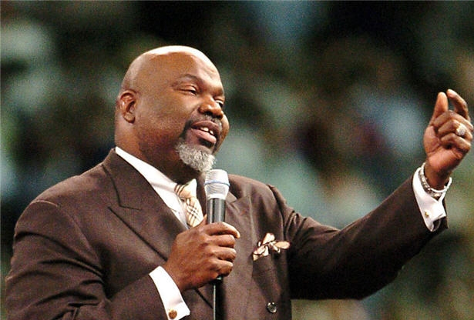
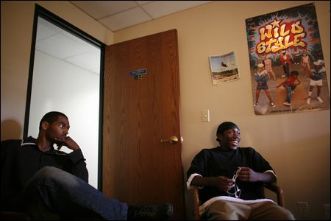
It will also take the entire community to build the Hero!

Slide 19
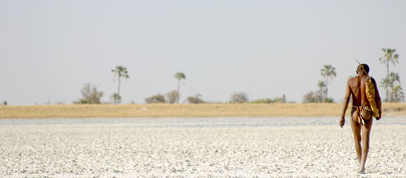
This is only the beginning of the path we must all take as Heroes! It’s a journey that some of us avoid at all cost for most of our lives.

Slide 20
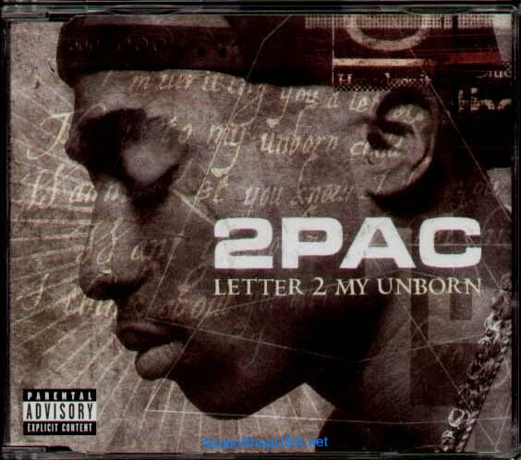
Though the road is long and the travel is often times harsh, this can become the point where we begin to see the light.

Slide 21
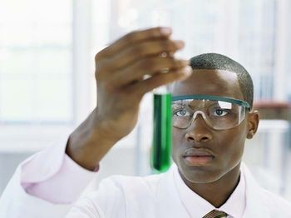

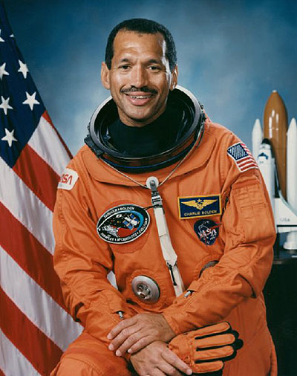
As we grow and become stronger, we develop a ton of skills & knowledge

Slide 22
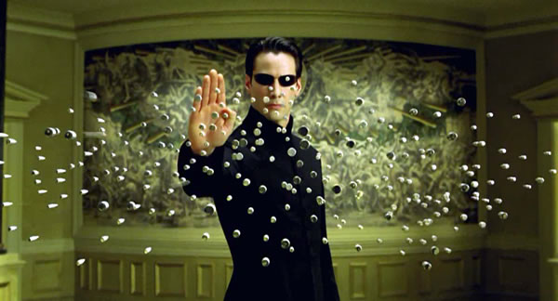
This is where a true sense of self is cultivated. The release from previous self-image ideals may allow a more powerful you to emerge!

Slide 23
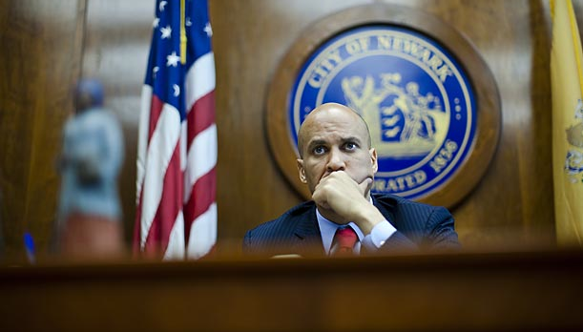
The person who can come forth from the Hero’s experience, may have always been filled with adventure and a strong desire for achievement! Able to face a variety of challenges……

Slide 24
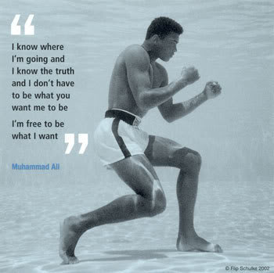
…..and willing to be different at all costs

Slide 25
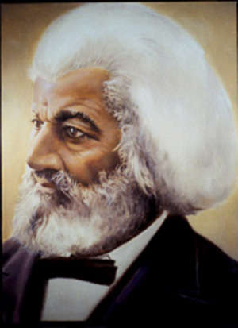
Heroes are willing
to make great sacrifices…..

Slide 26
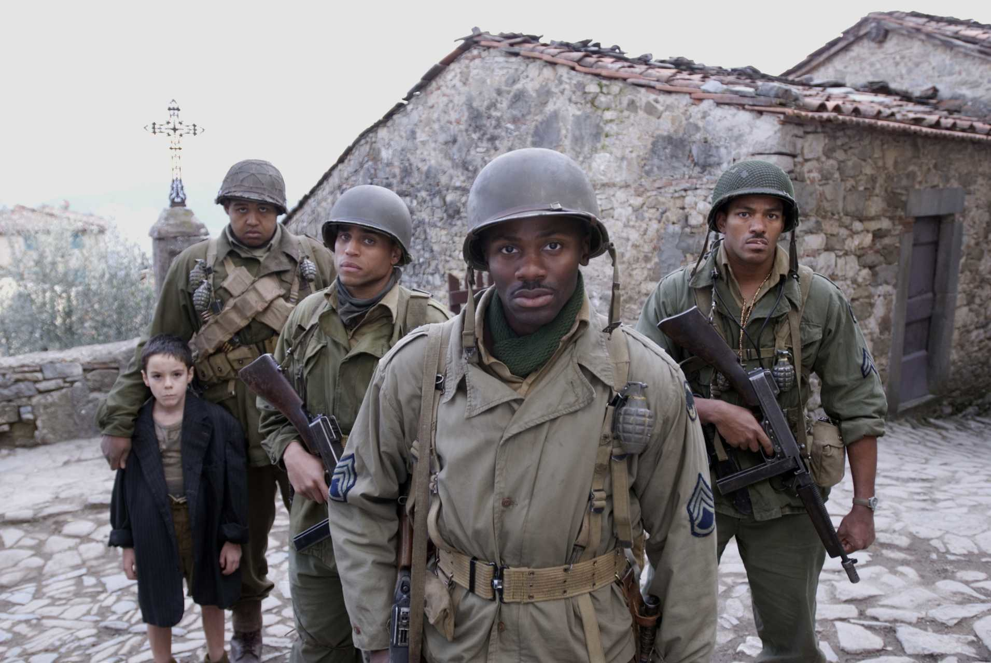
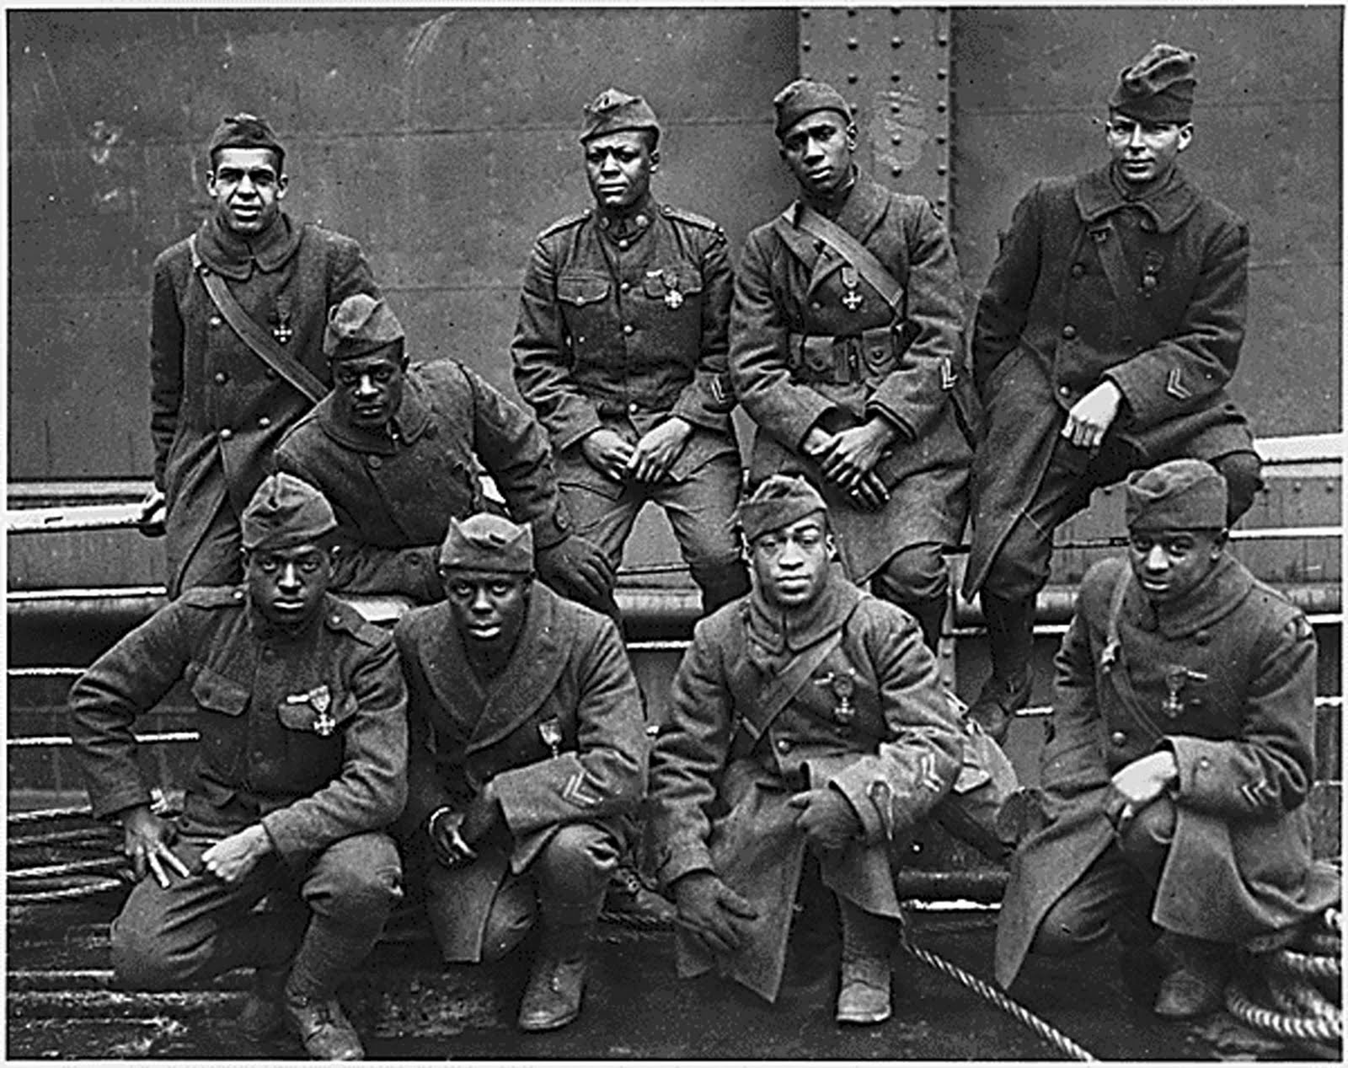
Heroes often push
themselves to grave limits….
….taking extreme risk and going beyond all expectations….

Slide 27
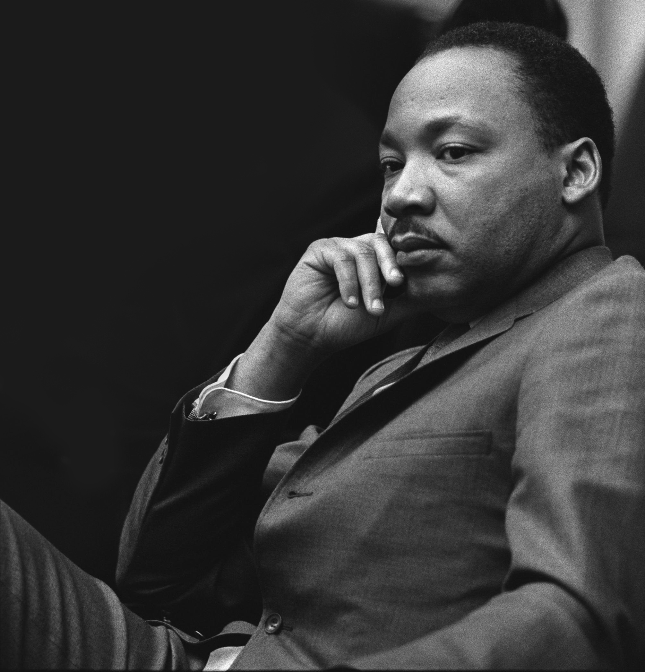
….Heroes take on all adversaries and hold up a belief that others can cling to, while winning the heart of those most dear to their hearts!

Slide 28
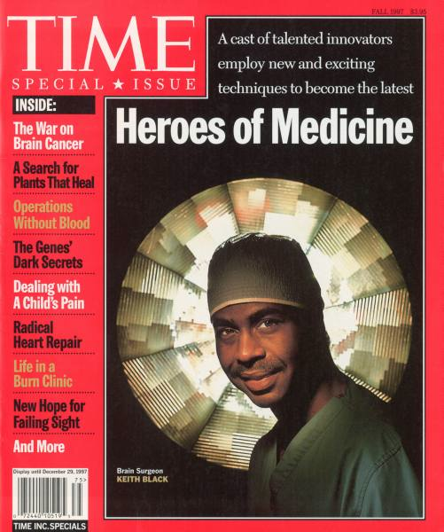
….Real people, real Heroes….these are real people like you and I.

Slide 29
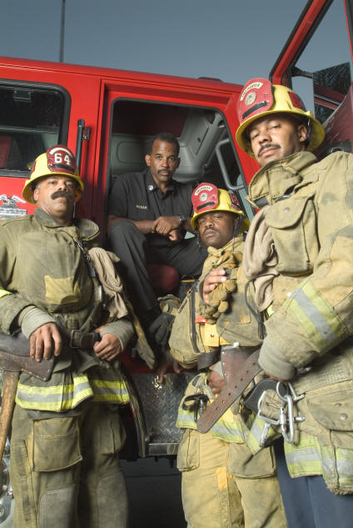
Here is where the real value of an individual can develop
Not only do you become sure of yourself, now others begin to recognize you, and trust you with certain responsibilities!

Slide 30
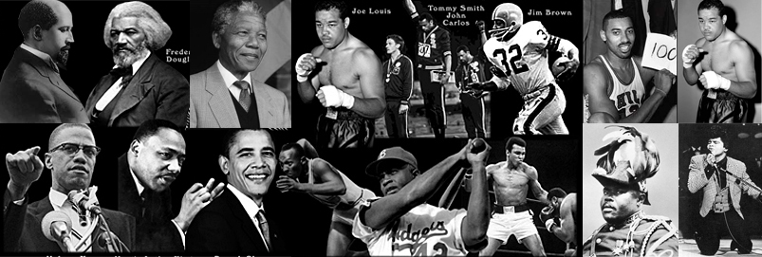
Many Heroes
Many Faces

Slide 31
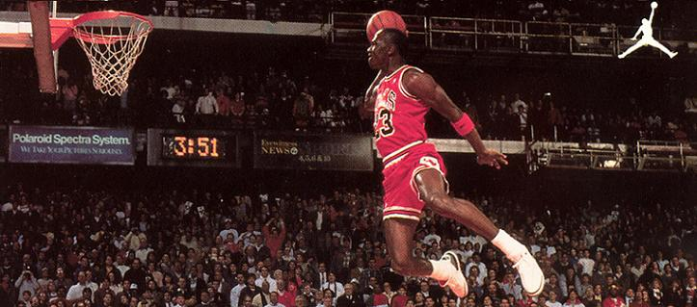
Once the Hero learns his own
Strength, this can be
the point where he begins
to spread his wings!

Slide 32
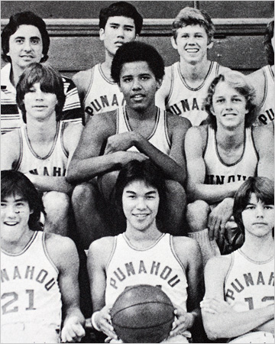
Taking this opportunity to lead.
Accomplishing goals that no one else thought you would
ever be able to achieve!
Barack Obama

Slide 33
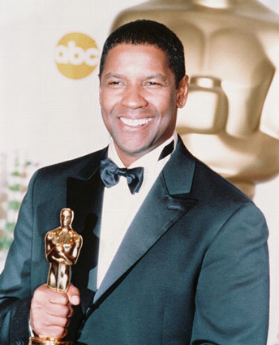
Learn how to show gracefulness in your accomplishments. Be authentic in what you do.

Slide 34
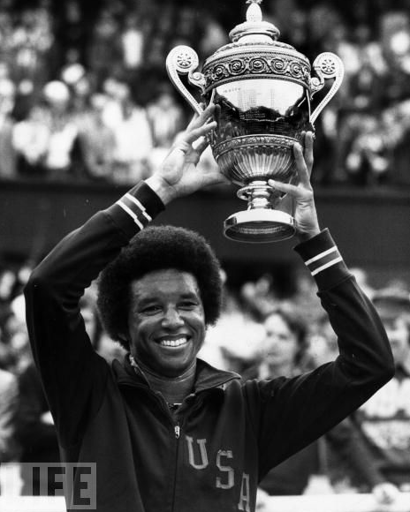
Show the world your value, morals and purity. Do what know one else has done before you!

Slide 35
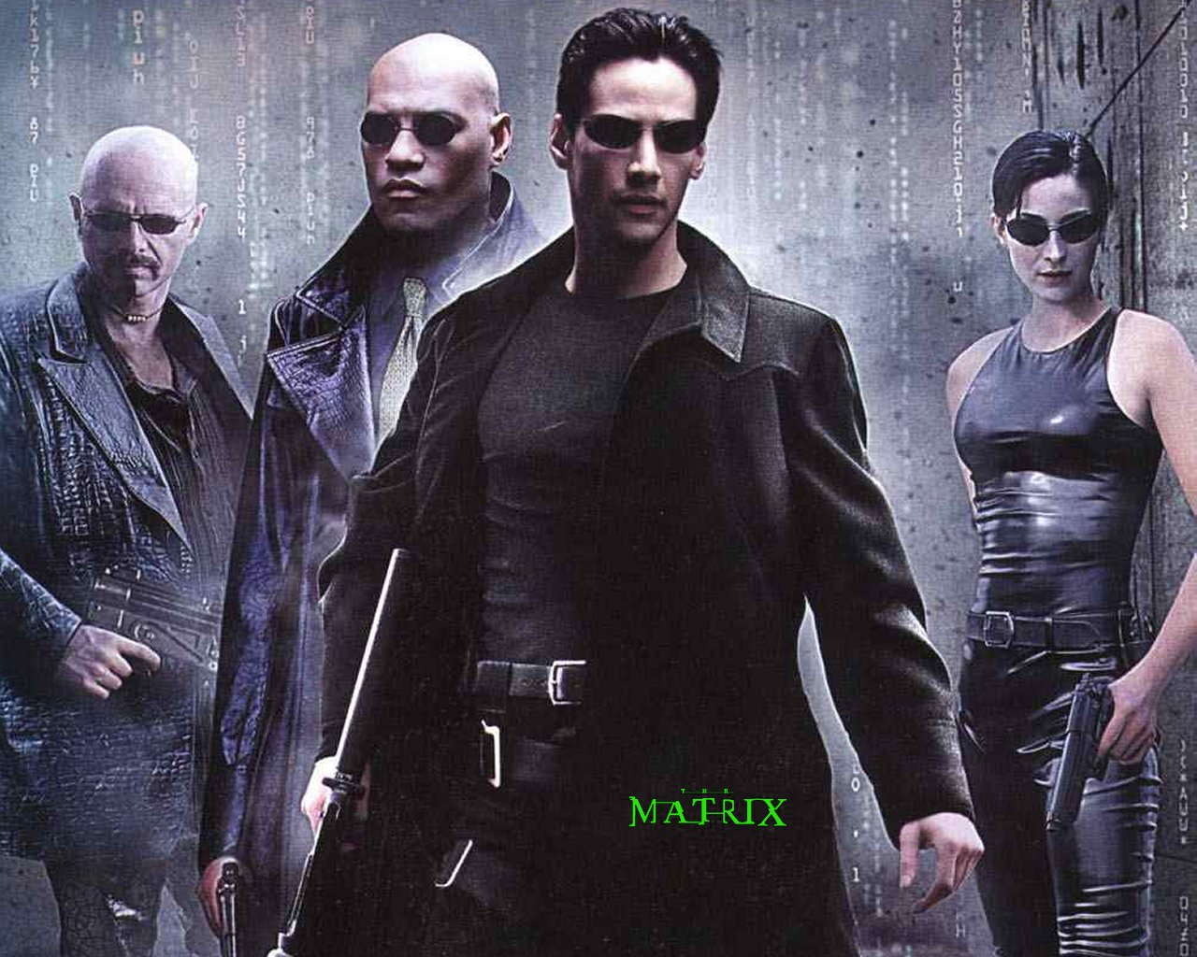
Live outside the MATRIX!

Slide 36
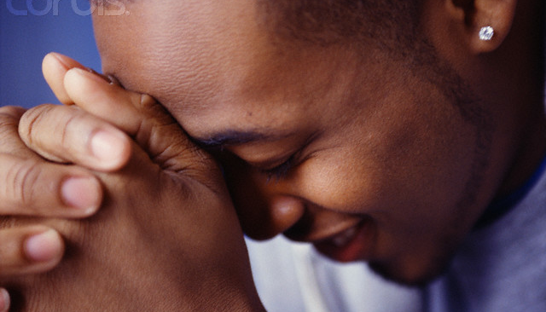
Continue to believe! When all others think that you have reached your limit, show them by example that there can be no limits! Trust yourself and what is true within you! Believe & Achieve! Progress! Be the Hero!

Slide 37
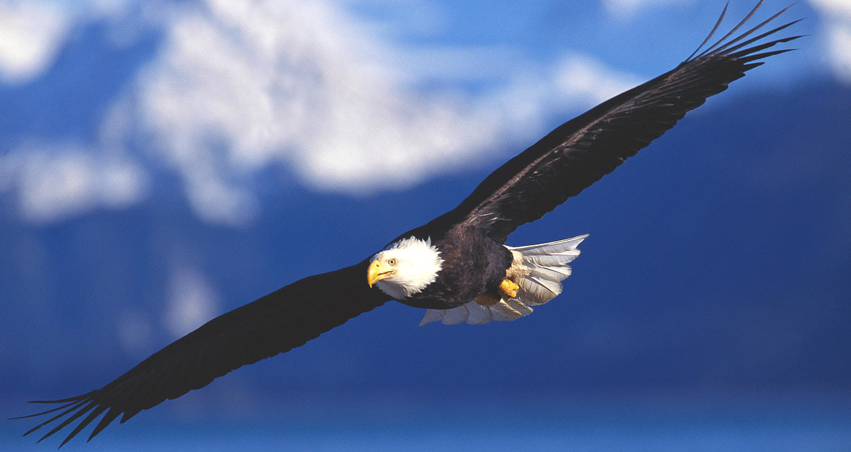
SOAR! SOAR with regal wings!
Lauderdale Lakes Educational Complex
“where heroes are born for generations”
Rites of Passage

Slide 39
CREED OF TIMBUKTU
AS A SON OF TIMBUKTU, I BELIEVE IN THE ONENESS OF GOD AND THE UNITY OF AFRICAN PEOPLE.
I AM THE SHINING EXAMPLE OF ALL HUMANITY.
I COME FROM A LONG TRADITION OF STRIVING FOR EXCELLENCE AND REPRESENTING THE BEST IN ALL THINGS.
MY CHARICTER, VISION AND INTEGRITY WILL ALWAYS REMAIN STRONG.
IN MY HANDS I PROUDLY CARRY THE LIGHTAND THE POWER TO GUIDE MY LIFE, TO PROVIDE FOR MY FAMILY AND UPLIFT MY COMMUNITY.
I ATTEST THAT EDUCATION, HEALTH, MORALITY, COURAGE AND PERSEVERANCE ARE THE CHARACTERISTICS OF MY TRUE SELF.
I SHALL BECOME A BUILDER OF PROSPERITY WEARING THE ARMOR OF FREEDOM, INTELLIGENCE, STRENGTH, TRANSFORMATION AND EMPOWERMENT.
I SHALL REMAIN FAITHFUL WITH DIGNITY AND BE RESPECTFUL TO MY SISTERS AT ALL TIME.
MY WORD IS BOND
THIS CREED I SHALLKEEP.
I AM A SON OF TIMBUKTU

Slide 40
Rites of Passage

